Slide 1

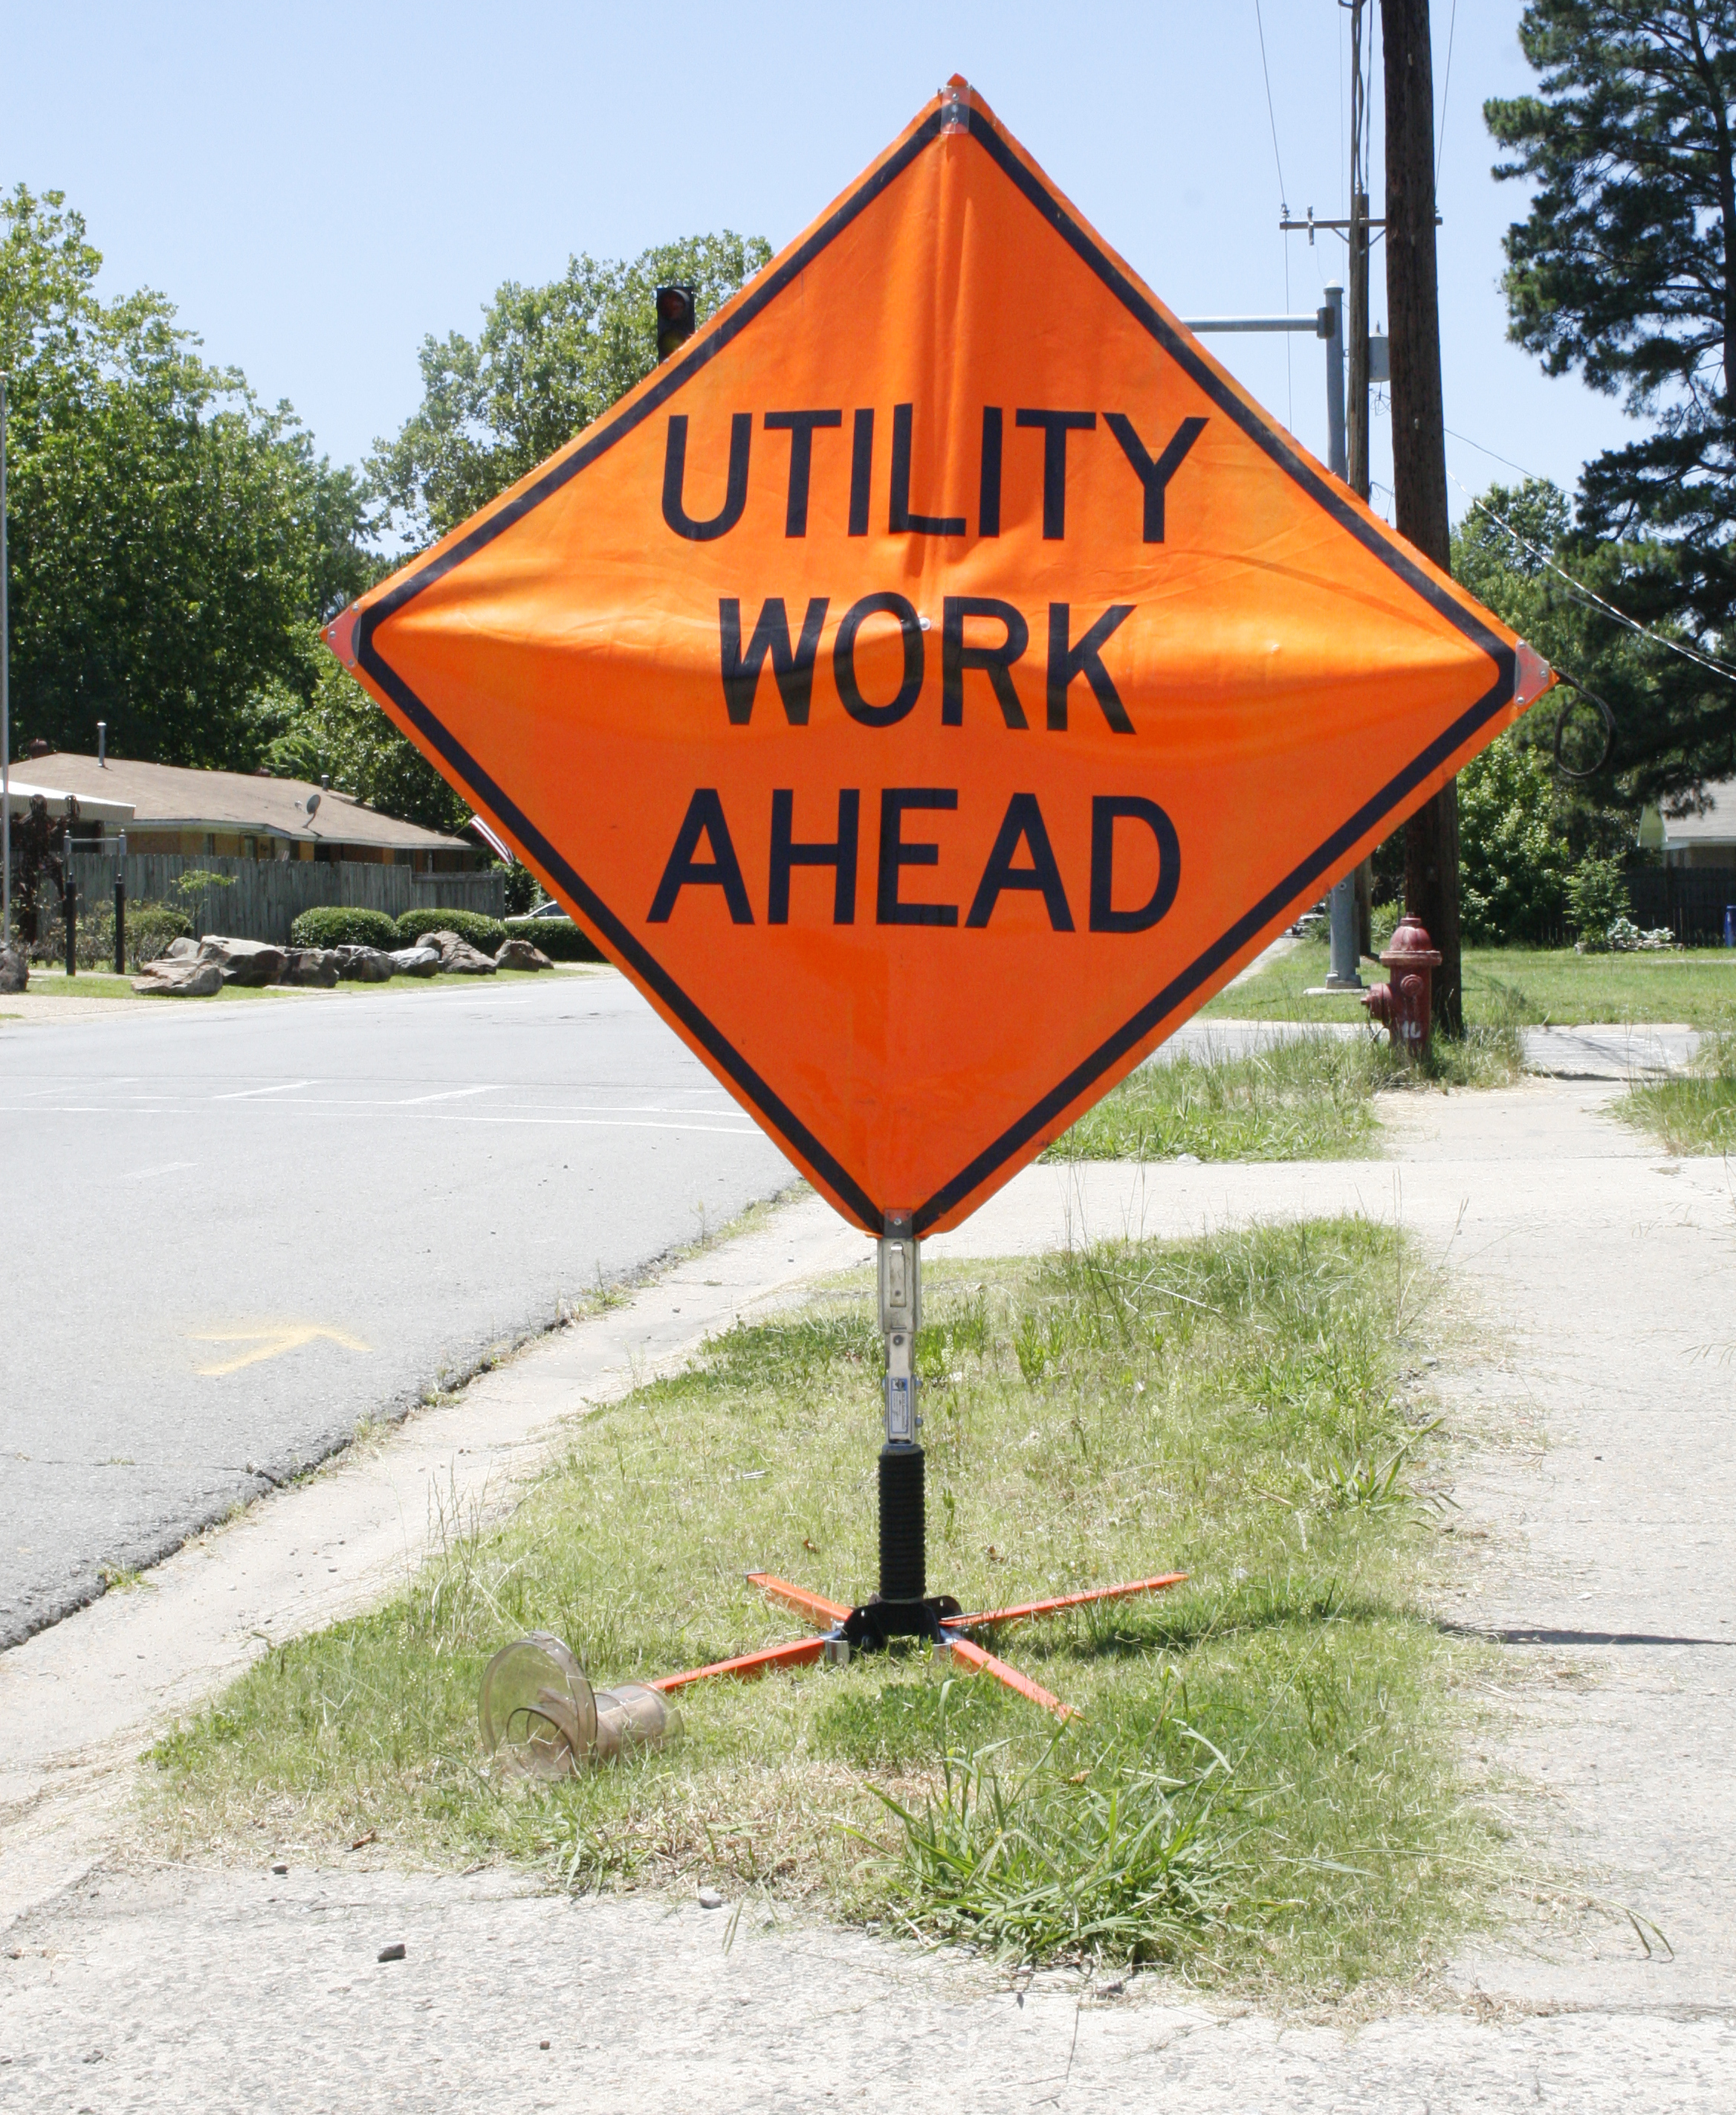
How to Read Daily Audit Reports

Slide 2
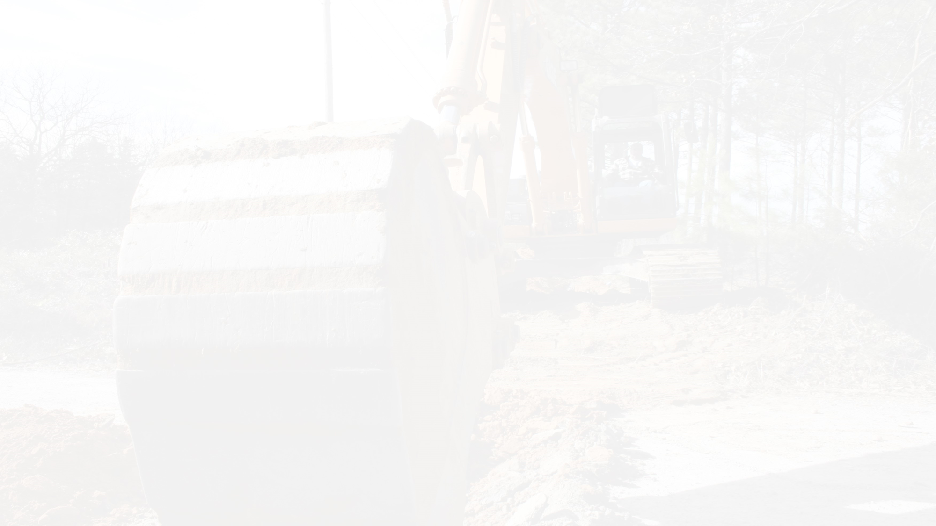
From
Call Center sending the audit.

Slide 3
Audit For
The date the report was generated.

Slide 4
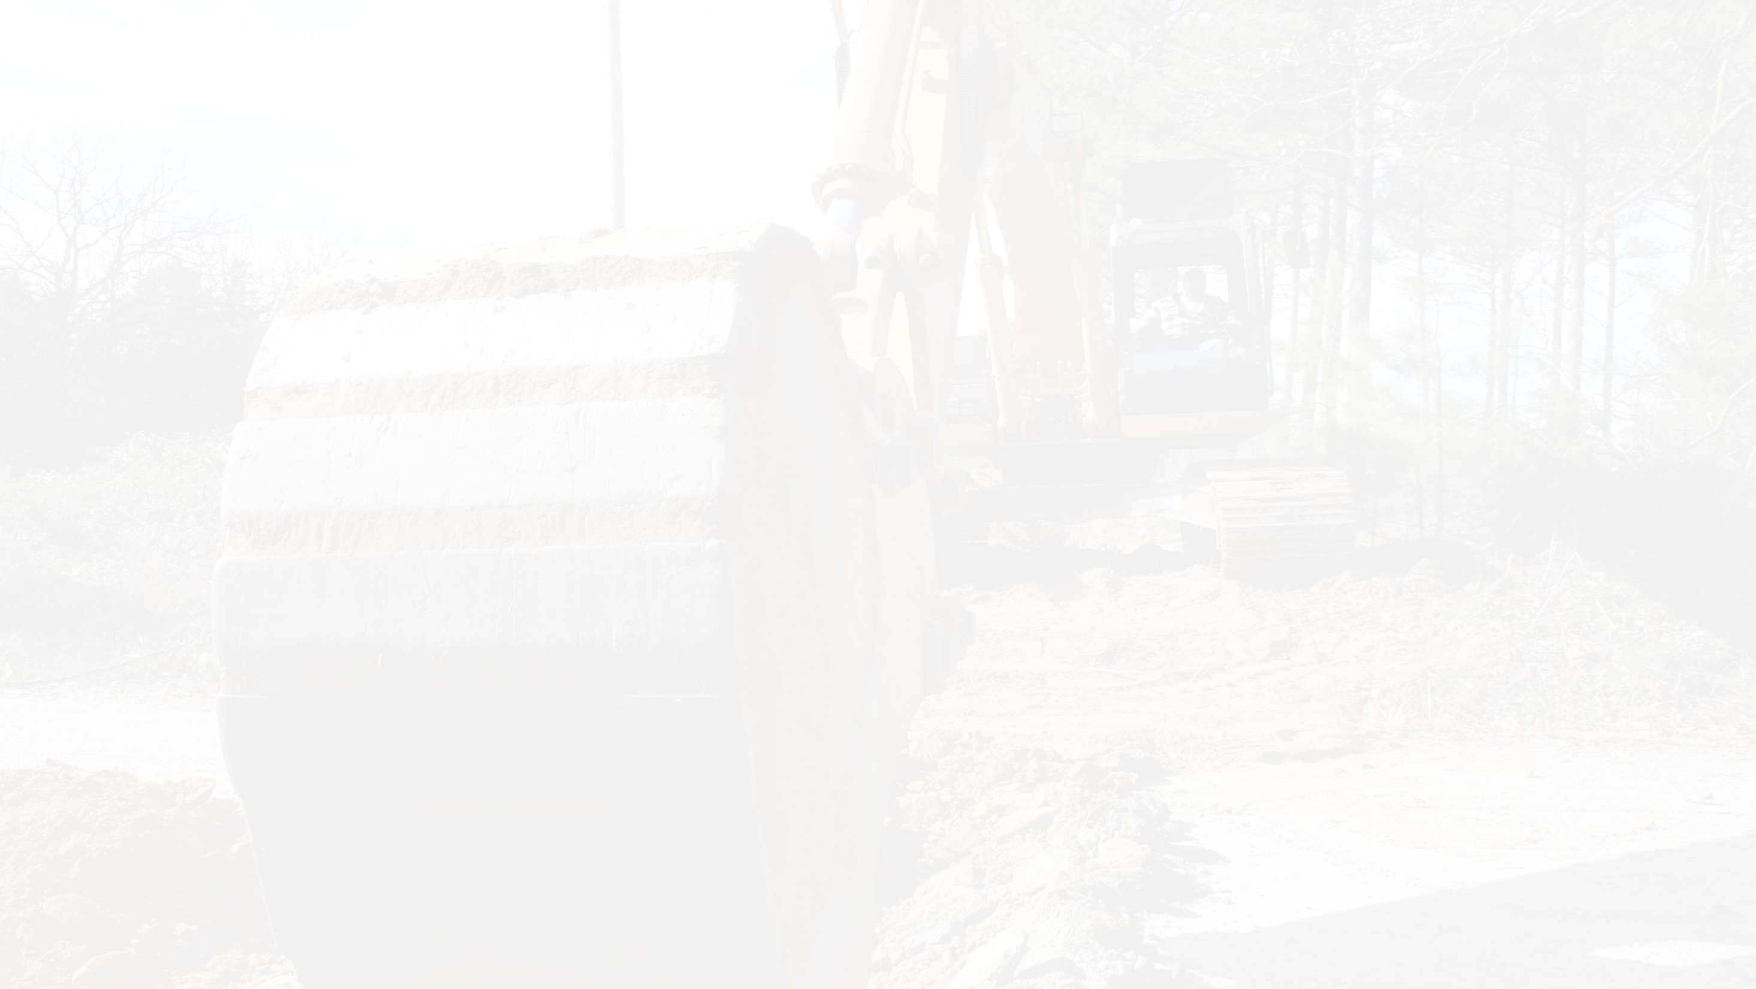
For Output
Name of the output the report was generated for.

Slide 5
For Code
Member dispatch code(s) the report was generated for.

Slide 6
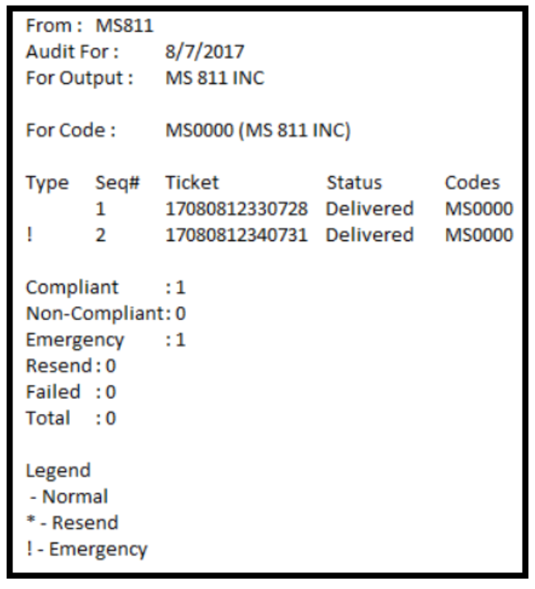
This section contains a list of all tickets that should have been transmitted to the above Output .

Slide 7
Type & Legend
Normal: If the ticket was Normal, there will not be a symbol listed under Type.
Resend: If the ticket was resent, there will be an asterisk * under Type.
Emergency: if the ticket was an Emergency, there will be a exclamation mark ! under Type.

Slide 8
Seq#
These numbers indicate the order in which tickets were transmitted to the output above, for the day.

Slide 9
Ticket
Ticket number(s)

Slide 10
Status
Delivered: Indicates that the ticket was successfully sent.
Failed: Indicates that the ticket failed to transmit.

Slide 11
Codes
Dispatch Code(s)

Slide 12
Compliant: ticket was sent with the allotted 2 working days notice.
Non-Compliant: ticket was not submitted with the allotted 2 working days notice.
Emergency: an "Emergency excavation" was submitted due danger to life, health or property or a customer service outage.
Resend: indicates the ticket was resent to the dispatch code.
Failed: indicates the ticket was not able to be transmitted (example: fax unplugged, fax down, out of ink or email full, etc.)
Total: this is the total number of tickets transmitted.

Slide 13

Thank You For Keeping
Mississippi Safe!!!

