Slide 1
How To Read MS811 Locate Request Tickets

Slide 2
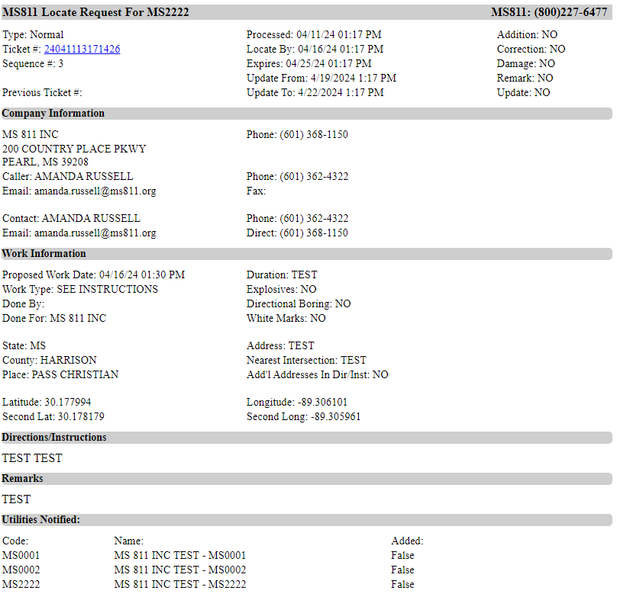
Dispatch code the ticket is being sent to.
**The dispatch code is only relevant to member companies.**

Slide 3
Type
This is the Ticket Priority Type.

Slide 4
Ticket Types
Cancel Req: The excavation previously reported has been canceled. Underground utilities NO LONGER need to be marked.
Design: Submitted by a professional service in preparation for bidding, preconstruction engineering, or other advance planning efforts that do not involve excavation. Required response time is 7 WORKING DAYS.
Emergency: Locate Request involving danger to life, health or property or a customer service outage. Required response time is 3 WORKING DAYS.
No Response: Utility owner or operators failed to respond to the previous locate request within 3 working days. Required response time is 2 HOURS.
Normal: Standard request submitted no less than 3, but no more than 10 working days prior to excavation. Required response time is 3 WORKING DAYS.
Short Notice: Excavator has requested that lines be marked sooner than 3 working days. A Short Notice Request is ONLY a request and is not binding or mandated by law. Required response time is 3 WORKING DAYS.
Unmarked: Utilities have responded, but the wrong area was marked, the entire excavation area was not marked or a unmarked utility was found (active or abandoned) while excavating. Required response time is 2 HOURS.
Notes:
Revised 4/11/24

Slide 5
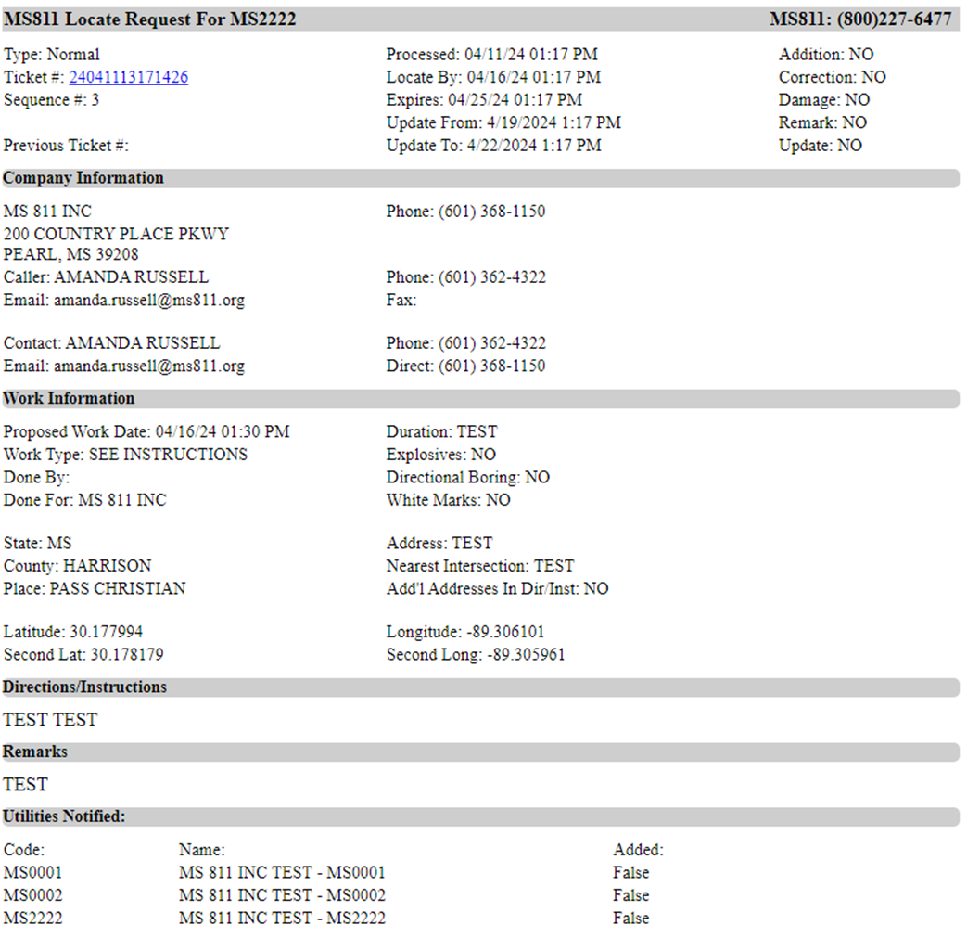
Ticket #
This is the verification number for all the information contained within this locate request.

Slide 6
Date
yy/mm/dd
Military Time
hh/mm
Sequence
690 ticket of the day

Slide 7
Sequence #
This number indicates how many tickets have been sent to the member dispatch code for the day.
**The sequence # is only relevant to member companies.**

Slide 8
Previous Ticket #
This is the prior ticket number. A change (update, correction, etc.) was made to the previous ticket resulting in this new ticket.

Slide 9
Processed
Date & time the ticket was created.

Slide 10
Locate By
The date & time lines should be located by law.

Slide 11
Expires
The date & time the ticket will expire.

Slide 12
Update From & Update To
The ticket should be updated between these two dates & times.

Slide 13
YES indicates that the following are true:
Addition: The previous ticket was resent due to additional information added.
Correction: The previous ticket was resent due to information corrected.
Damage: Lines were damaged during excavation.
Remark: Work on previous ticket has not been completed & the job site needs to be remarked due to markings have been destroyed.
Update: Work on previous ticket has not been completed & the ticket is being renewed prior to expiration.

Slide 14
Company Information
This section contains the contact information for the company that submitted the locate request.

Slide 15
Company Name , Address & Phone

Slide 16
Caller
This is the contact information for the person that submitted the locate request.
Caller
Email
Phone
Fax

Slide 17
Contact
This is the contact information for the person that should be contacted if there are any questions about the locate request.
Contact
Email
Phone
Alt (Alternate Phone #)
**The alternate phone should be 1st point of contact.**

Slide 18
Work Information
This section contains information about the work that is being done.

Slide 19
Proposed Work Date
Proposed date & time the work is to begin.

Slide 20
Work Type
Type of excavation work being done.

Slide 21
Done By
Excavator doing the work. This is often blank unless the caller is not also the excavator.

Slide 22
Done For
Who the work is being done for.

Slide 23
State
State work is being done in. MS811 only processes locate requests for work being done in Mississippi.

Slide 24
County
County work will be done in.

Slide 25
Place
The city or town closest to the excavation site.

Slide 26
Latitude/Longitude
Second Lat/ Second Long
The coordinates displayed in this section of a ticket are generated according to the method the person processing the locate request used to mark the excavation area on the map.

Slide 27
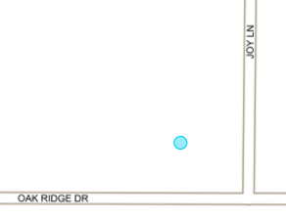
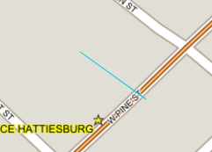
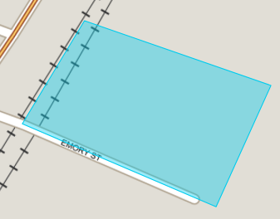
Latitude/Longitude
Second Lat/ Second Long
Point: The Latitude/Longitude & the Second Lat/Second Long coordinates are the same when the excavation site was marked using a point marking tool.
Line: When the line marking tool is used, the Lat/Long coordinates are the beginning point of the line & the Second Lat/Long coordinates are the ending point of the line.
Polygon: When the polygon marking tool is used, the Lat/Long coordinates are the bottom left corner of the polygon & the Second Lat/Long coordinates are the top right corner of the polygon.

Slide 28
Duration
Amount of time it will take to complete the work.

Slide 29
Explosives
If YES, explosives will be used.

Slide 30
Directional Boring
If YES, directional boring equipment will be used.

Slide 31
White Marks
If YES, the excavation site will be marked with white paint, flags, etc.

Slide 32
Address
The address or street work will be done at or on.

Slide 33
Nearest Intersection
The nearest intersection to the job site.

Slide 34
Add’l Addresses in Dir/Inst
If YES, there will be additional addresses listed in the directions/instructions field.

Slide 35
Directions/Instructions
Driving directions to dig site & instructions for where to mark underground utilities.

Slide 36
Remarks
Any additional instructions or information provided by the caller, or notes about Emergency, No Response, Remark, etc.

Slide 37
Utilities Notified
This section contains the list of member utility companies notified to locate their underground lines.

Slide 38
Code
Member dispatch codes.

Slide 39
Name
Member utility company name.

Slide 40
Added
False: The member is being notified because their service area was within 300 feet of the reported excavation site.
True: The member was not automatically selected by the system. However, they were manually added to the ticket because the caller indicated that the company has or may have underground utilities on or near the excavation site.

Slide 41
Thank You For Keeping
Mississippi Safe!!!

